Slide 1

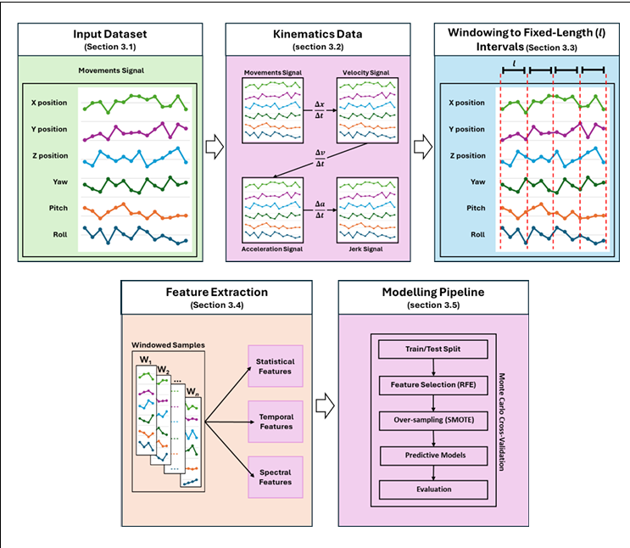
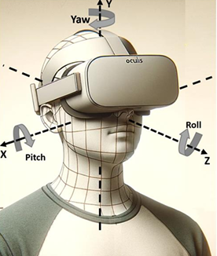
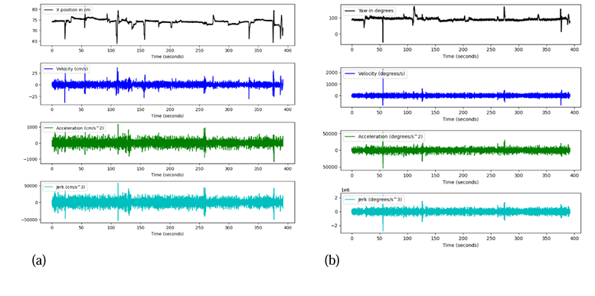
Virtual Reality Sickness Prediction Model
Rishitha T, Afrin Banu, Dr. A. Sathya*
Sri Ramachandra Faculty of Engineering and Technology, SRIHER(DU), Chennai, Tamil Nadu - 600116
* Project Mentor
Introduction
Virtual Reality (VR) sickness prediction models leverage machine learning to analyze motion patterns, positional and orientational data, and user interactions. By identifying factors contributing to discomfort, these models help anticipate nausea and dizziness.
These models use real-time data processing to detect early symptoms and adapt VR settings dynamically. They enhance accuracy in predicting sickness ,optimizing VR environments for better user comfort and experience.
Results and Discussion
Outlines pipeline: Input Dataset → Kinematics → Windowing → Feature Extraction → Modeling (train/test split, RFE, SMOTE, predictive models, Monte Carlo CV).
Validates robust, scalable approach for time-series data, ensuring generalizable predictions across VR applications.
VR’s immersive potential in gaming, training, and healthcare is limited by cybersickness. Current detection methods are invasive or subjective. This project predicts cybersickness in real-time using head movement data and machine learning, aiming to improve user comfort with a non-invasive, adaptive solution.
Problem Statement
Fig. 1. Methodology Flowchart for Cybersickness Prediction
Tracks X, Y, Z positions and yaw, pitch, roll rotations using VR headset sensors.
Enables non-invasive cybersickness detection, suggesting real-time VR adjustments for user comfort and future integration with eye-tracking.
Methodology
9
Data Collection
Fig 2. Head Movement Axes in VR (Oculus Headset)
Feature Extraction & Preprocessing
X-position and yaw derivatives (velocity, acceleration, jerk) reveal dynamic patterns.
X-position jerk peaks at ±5000 cm/s³, yaw jerk at ±2 deg/s³, indicating higher instability in "sick" users.
Suggests sensory mismatch as a cybersickness trigger, encouraging further temporal feature exploration for real-time detection.
Model Development & Training
Evaluation & Optimization
Classification
Fig 3. Kinematic Derivatives of Head Movements
Application
Training: Improves VR-based simulations (e.g., flight, medical) by minimizing discomfort.
Healthcare: Supports VR therapy (e.g., phobia treatment) with better patient tolerance.
Gaming: Reduces cybersickness, enhancing player immersion and session duration

